Slide 1
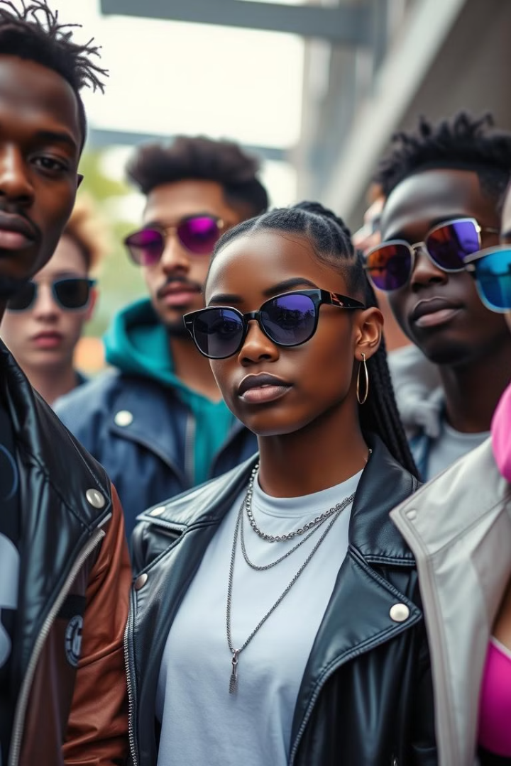

Rare Drip: Authentic Streetwear, Revolutionized
Rare Drip is a blockchain-powered NFT marketplace. It authenticates streetwear, connecting digital ownership with physical fashion. We address the $2.5B counterfeit market. Experience secure, transparent trading.
by Bunny Chokkam

Slide 2
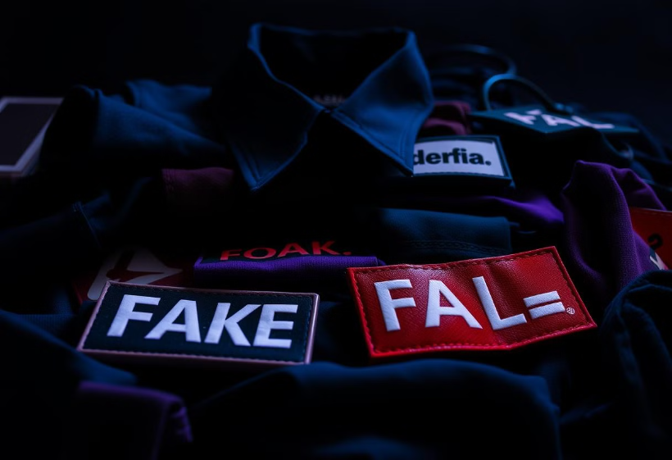
The $2.5B Streetwear Authentication Crisis
Counterfeit Market
40% of luxury streetwear is affected by counterfeits. This impacts brand integrity and consumer trust.
Traditional Methods
Traditional methods are slow and costly. They lack transparency and global scalability.
Blockchain Solution
Blockchain provides immutable proof of origin. This ensures trust in a $6B resale sneaker market.

Slide 3





Rare Drip: How It Works
NFT Authenticity
An NFT represents a digital certificate of authenticity.
Oppurtunity to resell purchased NFT
Sellers have verified profiles with reputation scores.
Smart Contracts
Smart contracts ensure transparent transaction history.
Redeem Your NFT for Exclusive Physical Clothing
Own a unique NFT? Get its exclusive physical clothing counterpart—designed just for you. One-of-a-kind, just like your digital asset!

Slide 4

Technical Architecture
MetaMask Integration
ERC-721 Standard
Seamless transactions enabled by MetaMask wallet integration.
Unique item representation using the ERC-721 token standard.
Decentralized Storage
Item metadata stored using IPFS decentralized storage.
Our architecture also features multi-factor authentication for seller verification and real-time blockchain transaction tracking.

Slide 5





Exceptional User Experience
One-Click Verification
Cross-Platform
24/7 Access
Low Fees
Enjoy one-click verification, mobile and desktop compatibility, 24/7 global access, and low transaction fees (2.5% vs 15% on traditional platforms) along with instant global shipping coordination.

Slide 6
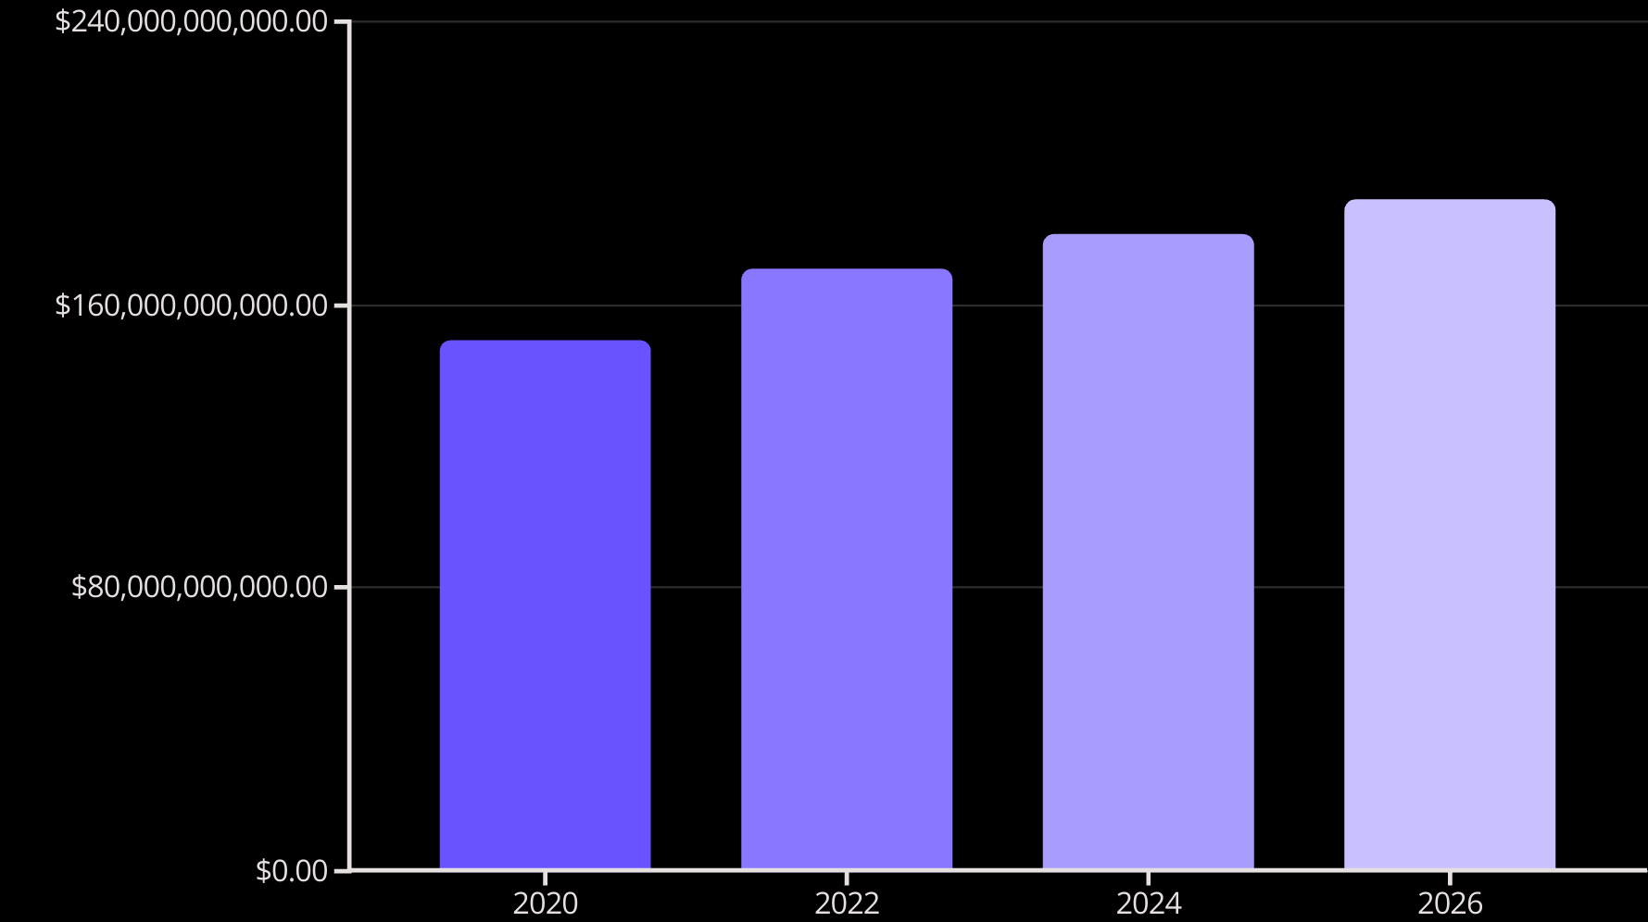
Massive Market Opportunity
The global streetwear market is projected to reach $190B by 2026. We target 18-35 year old fashion enthusiasts. There is growing demand for digital authentication. This presents an opportunity to disrupt the $25B sneaker resale market.

Slide 7

Project Implementation
How It Works
1. Admin lists NFT: uploads image, sets price in ETH, mints NFT
2. User buys NFT: connects wallet, pays in Sepolia ETH, receives NFT
3. Physical redemption: buyer requests delivery, admin ships item, NFT marked "redeemed"
4. Resale & verification: owners can resell, new buyers verify authenticity

Slide 8




Future Vision
Expand Categories
Global Network
AI Verification
Expand to luxury fashion categories.
Build a global authentication network.
Implement AI-enhanced verification.
Our future includes community governance through token ownership. We aim to break barriers between digital and physical fashion.

